Slide 1
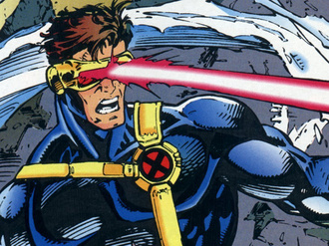
Laser Cat
Presented by:
Almeda Glenn Brandon Tan Troy Toh Lim Wei Heng
Credits are given to the pictures in this presentation

Slide 2
Disclaimer
Please note that the pictures provided in this presentation do not intend to infringe any copyright. Credits are given to the sources.
Our individual tasks and timeline

Slide 3
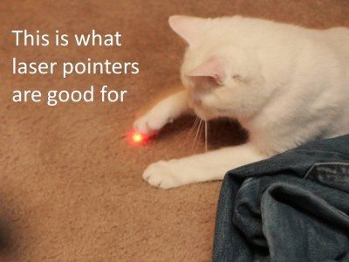

Slide 4
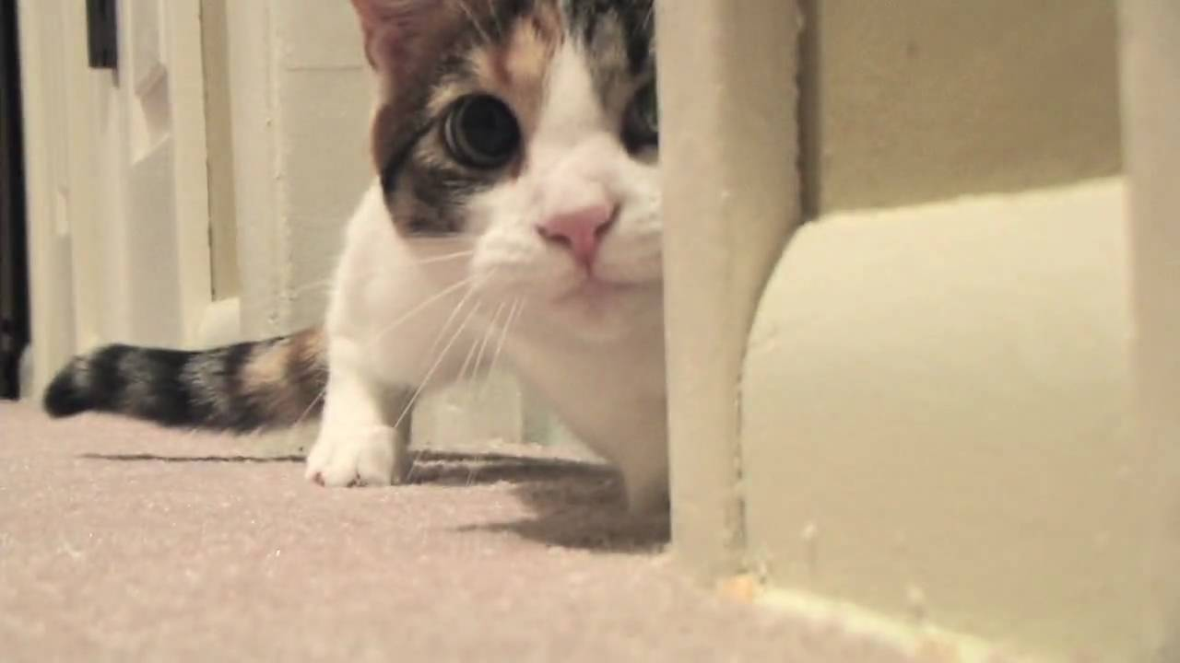
Overview
Our Tasks (extract from proposal)
Project Schedule (from excel sheet)
Gameplay Samples
Screenshots (Before & After)
Reviews(?)
Risks/Concerns
Random Inspirations

Slide 5
Our Tasks
Problem encounter and how we solved
How we improve our project better?
SML and who did what.

Slide 6
Our Tasks
Predicted (time taken)

Slide 7
Our Tasks
Actual figures (this might not be a relevant slide.)

Slide 8
Project Schedule
Insert Gantt Chart here…

Slide 9
Gameplay Samples

Slide 10
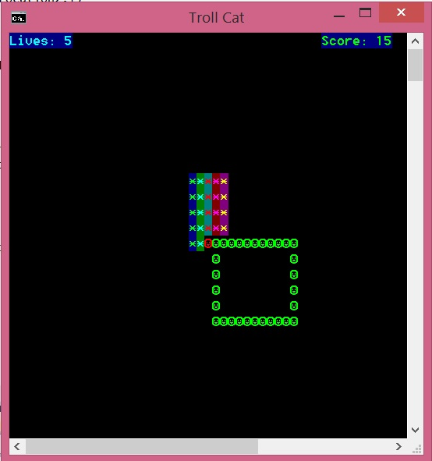
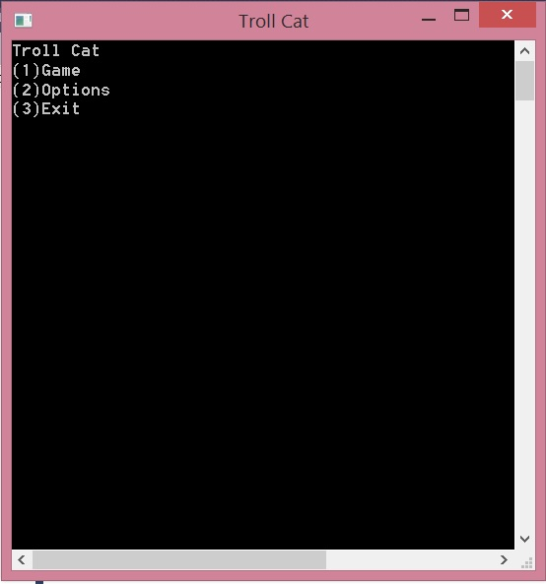
Screenshots (Before)
Initial Menu →
← Initial Gameplay

Slide 11
Screenshots (After)
//final product of the game

Slide 12

Risks/Problems/Concerns
//to brainstorm some potential issues we are aware of….

Slide 13
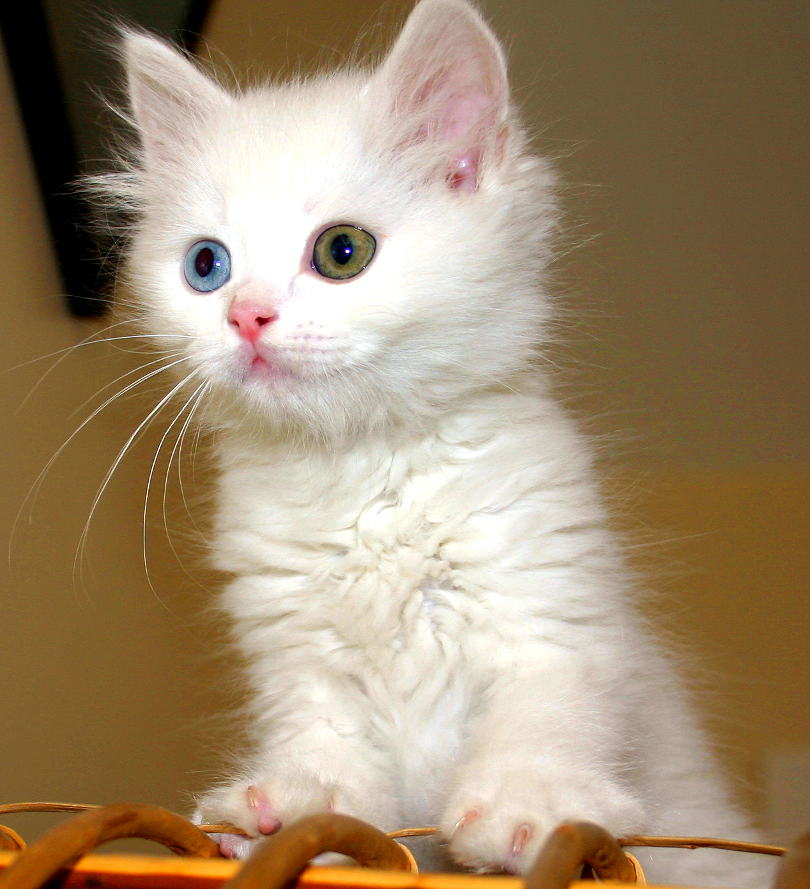
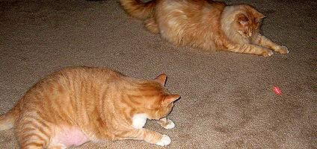
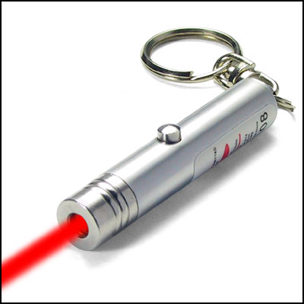
Inspirations

Slide 14
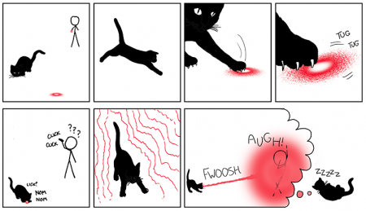
Inspirations

Slide 15
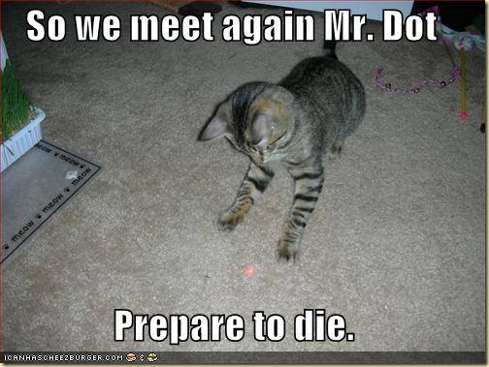

Slide 16
Thank You!!

